Slide 1
Lesson 2
GPIO pins and Interfacing with sensors
Tongtong Mike Ethan

Slide 2
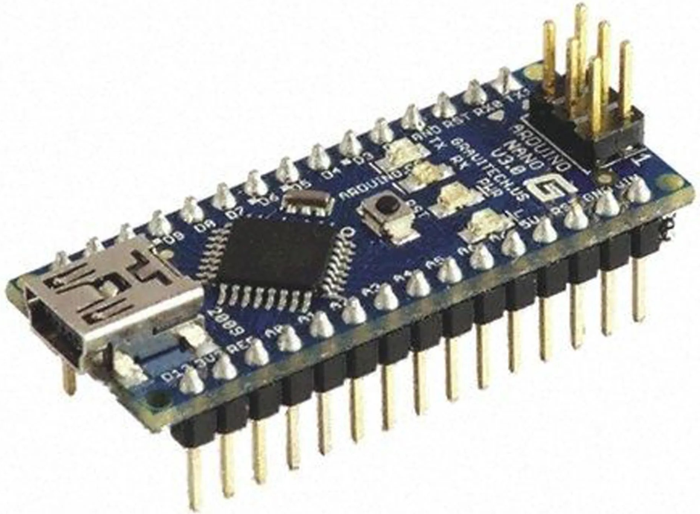
Pins
Legs of the microcontroller are called pins
Normally the functions of the pins range from input and output (we call these pins GPIO general purpose input output) and also power pins, the power pins allow you to boot the board without touching usb cable, and powering additional sensors from this one.

Slide 3
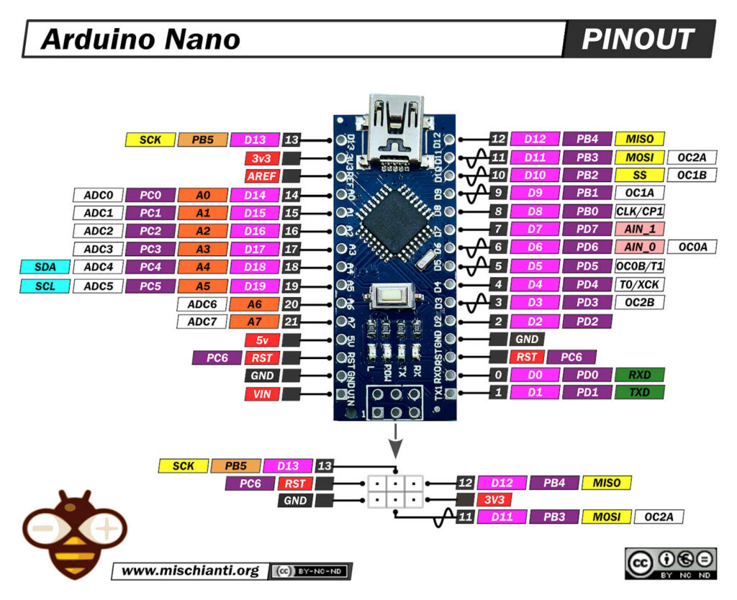
GPIO General purpose input output
GPIO pins are labeled with the letter D as labeled. pins with analog functions are labeled starting with A, and the two power pins 3v3 or 5v can be used to get a temporary source to power an additional sensor
These gpio pins can be configured on the fly, to be an input or an output within the code. Inputs sense

Slide 4
Sending data
Due to the sensing abilities of the gpio pins data can be transferred in-between chips.
For example a sensor could output power on a pin when a certain physical event ranging from a simple button press to receiving an infrared pulse.
this pin can be sensed by the microcontroller to determine if the action happened.

Slide 5
Serial data
Microcontroller operates extremely fast, we can send alot of information within a short period of time, imperceivable by humans
Encoder encodes input into binary using a standard communication protocol
Sends binary one wire
Sometimes has Clock to sync up data
Arduino
Encoder
…
Single wire Binary data bus

Slide 6
Serial data
Also works for non binary sensors such as analog temperature sensors and humidity sensors
Sending numerical temperature values through Serial.
Arduino
Temperature
Encoder
Humidity
Single wire Binary data bus

Slide 7
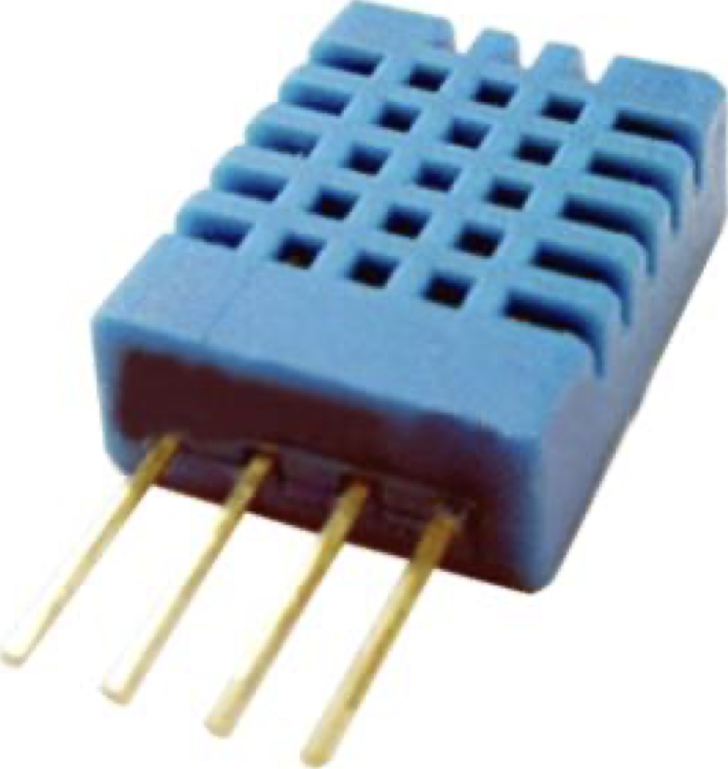
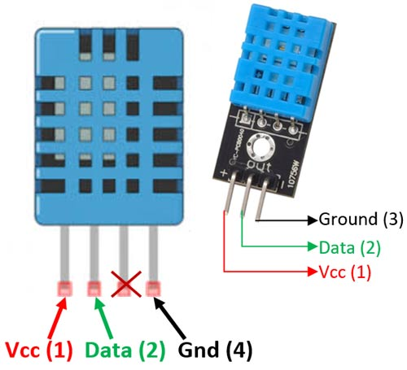
DHT11 Humidity & Temperature Sensor
Temperature & Humidity Sensor
Calibrated digital signal output
High reliability and excellent long-term stability
Resistive-type humidity measurement component
NTC temperature measurement component
Connects to high-performance 8-bit microcontroller
Anti-interference ability
Datasheet: https://www.mouser.com/datasheet/2/758/DHT11-Technical-Data-Sheet-Translated-Version-1143054.pdf

Slide 8
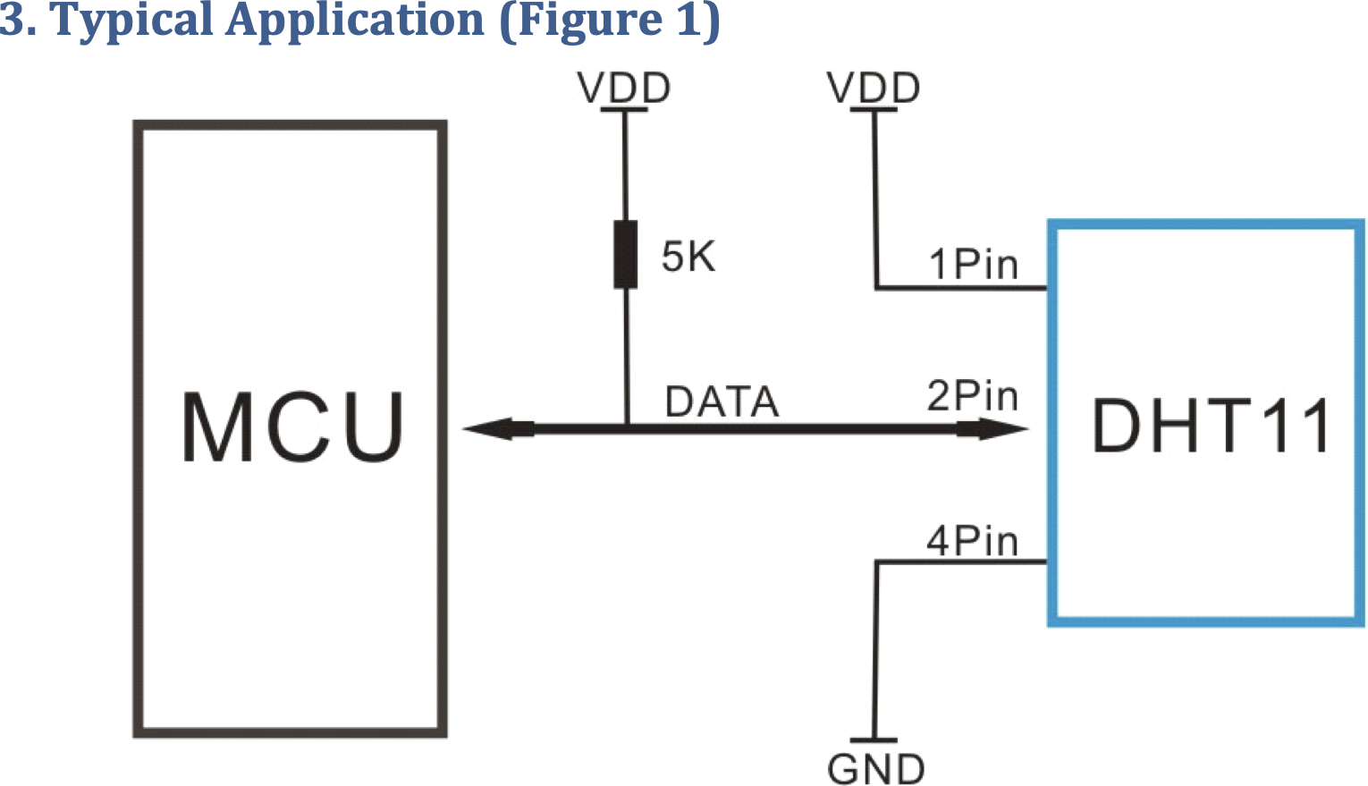
DHT11 Humidity & Temperature Sensor
DHT11’s power supply (VDD) is 3-5.5V DC.
Data pin: Serial Interface (Single-Wire Two-Way)

Slide 9
Overall Communication Process
MCU sends a start signal to DHT11.
DHT11 transitions from low-power-consumption mode to running mode.
DHT11 waits for MCU to complete the start signal.
After completion, DHT11 sends a 40-bit response signal containing humidity and temperature data to MCU.
Users have the option to collect (read) some or all of the data.
Without the start signal from MCU, DHT11 won't respond.
Once data is collected, DHT11 returns to low-power-consumption mode until it receives another start signal from MCU.

Slide 10
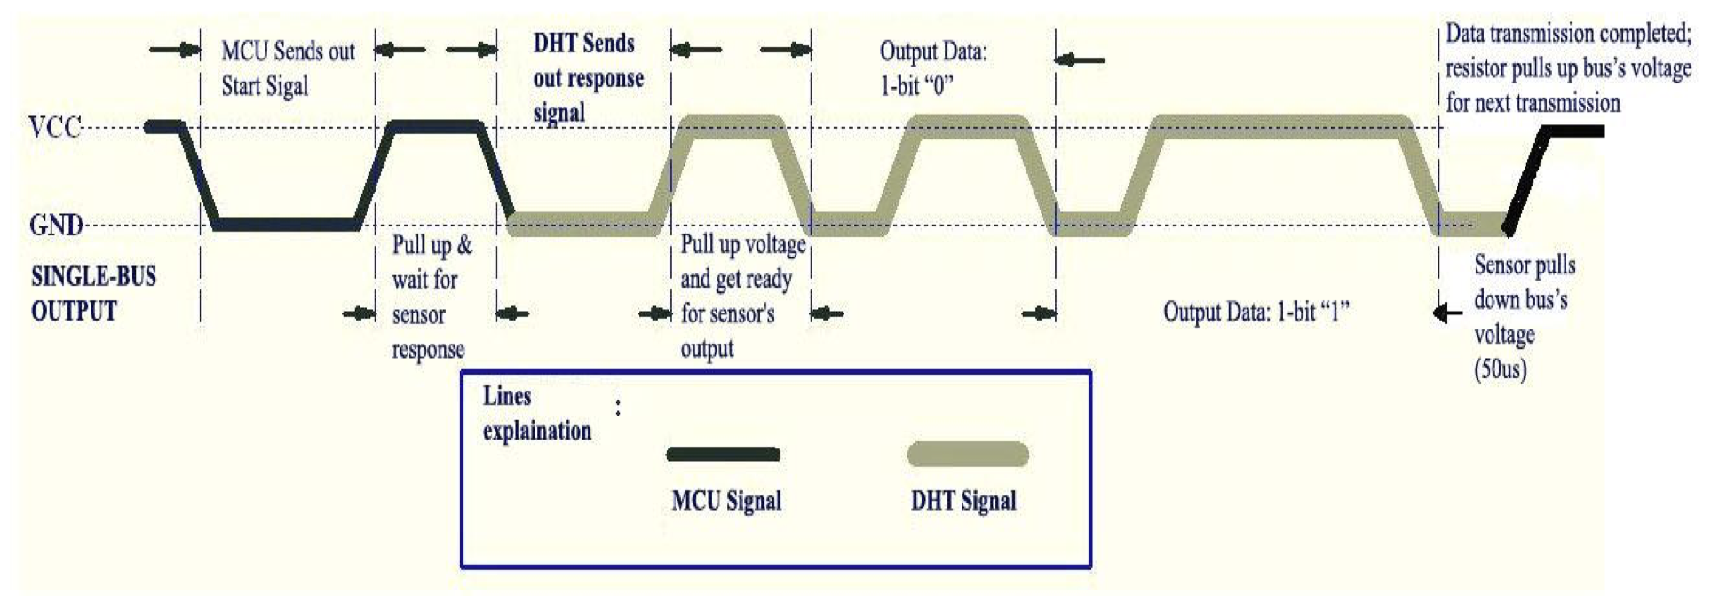
Overall Communication Process
Y axis (Voltage)
Data Sent over DHT11 Signal line
Logic state 1 (3v)
Logic state 0 (GND)
X axis (Time)

Slide 11
Overall Communication Process
MCU sends a start signal to DHT11.
DHT11 transitions from low-power-consumption mode to running mode.
DHT11 waits for MCU to complete the start signal.

Slide 12
Overall Communication Process
{
After completion, DHT11 sends a 40-bit response signal containing humidity and temperature data to MCU.

Slide 13
Overall Communication Process
Users have the option to collect (read) some or all of the data.
Without the start signal from MCU, DHT11 won't respond.
Once data is collected, DHT11 returns to low-power-consumption mode until it receives another start signal from MCU.

Slide 14
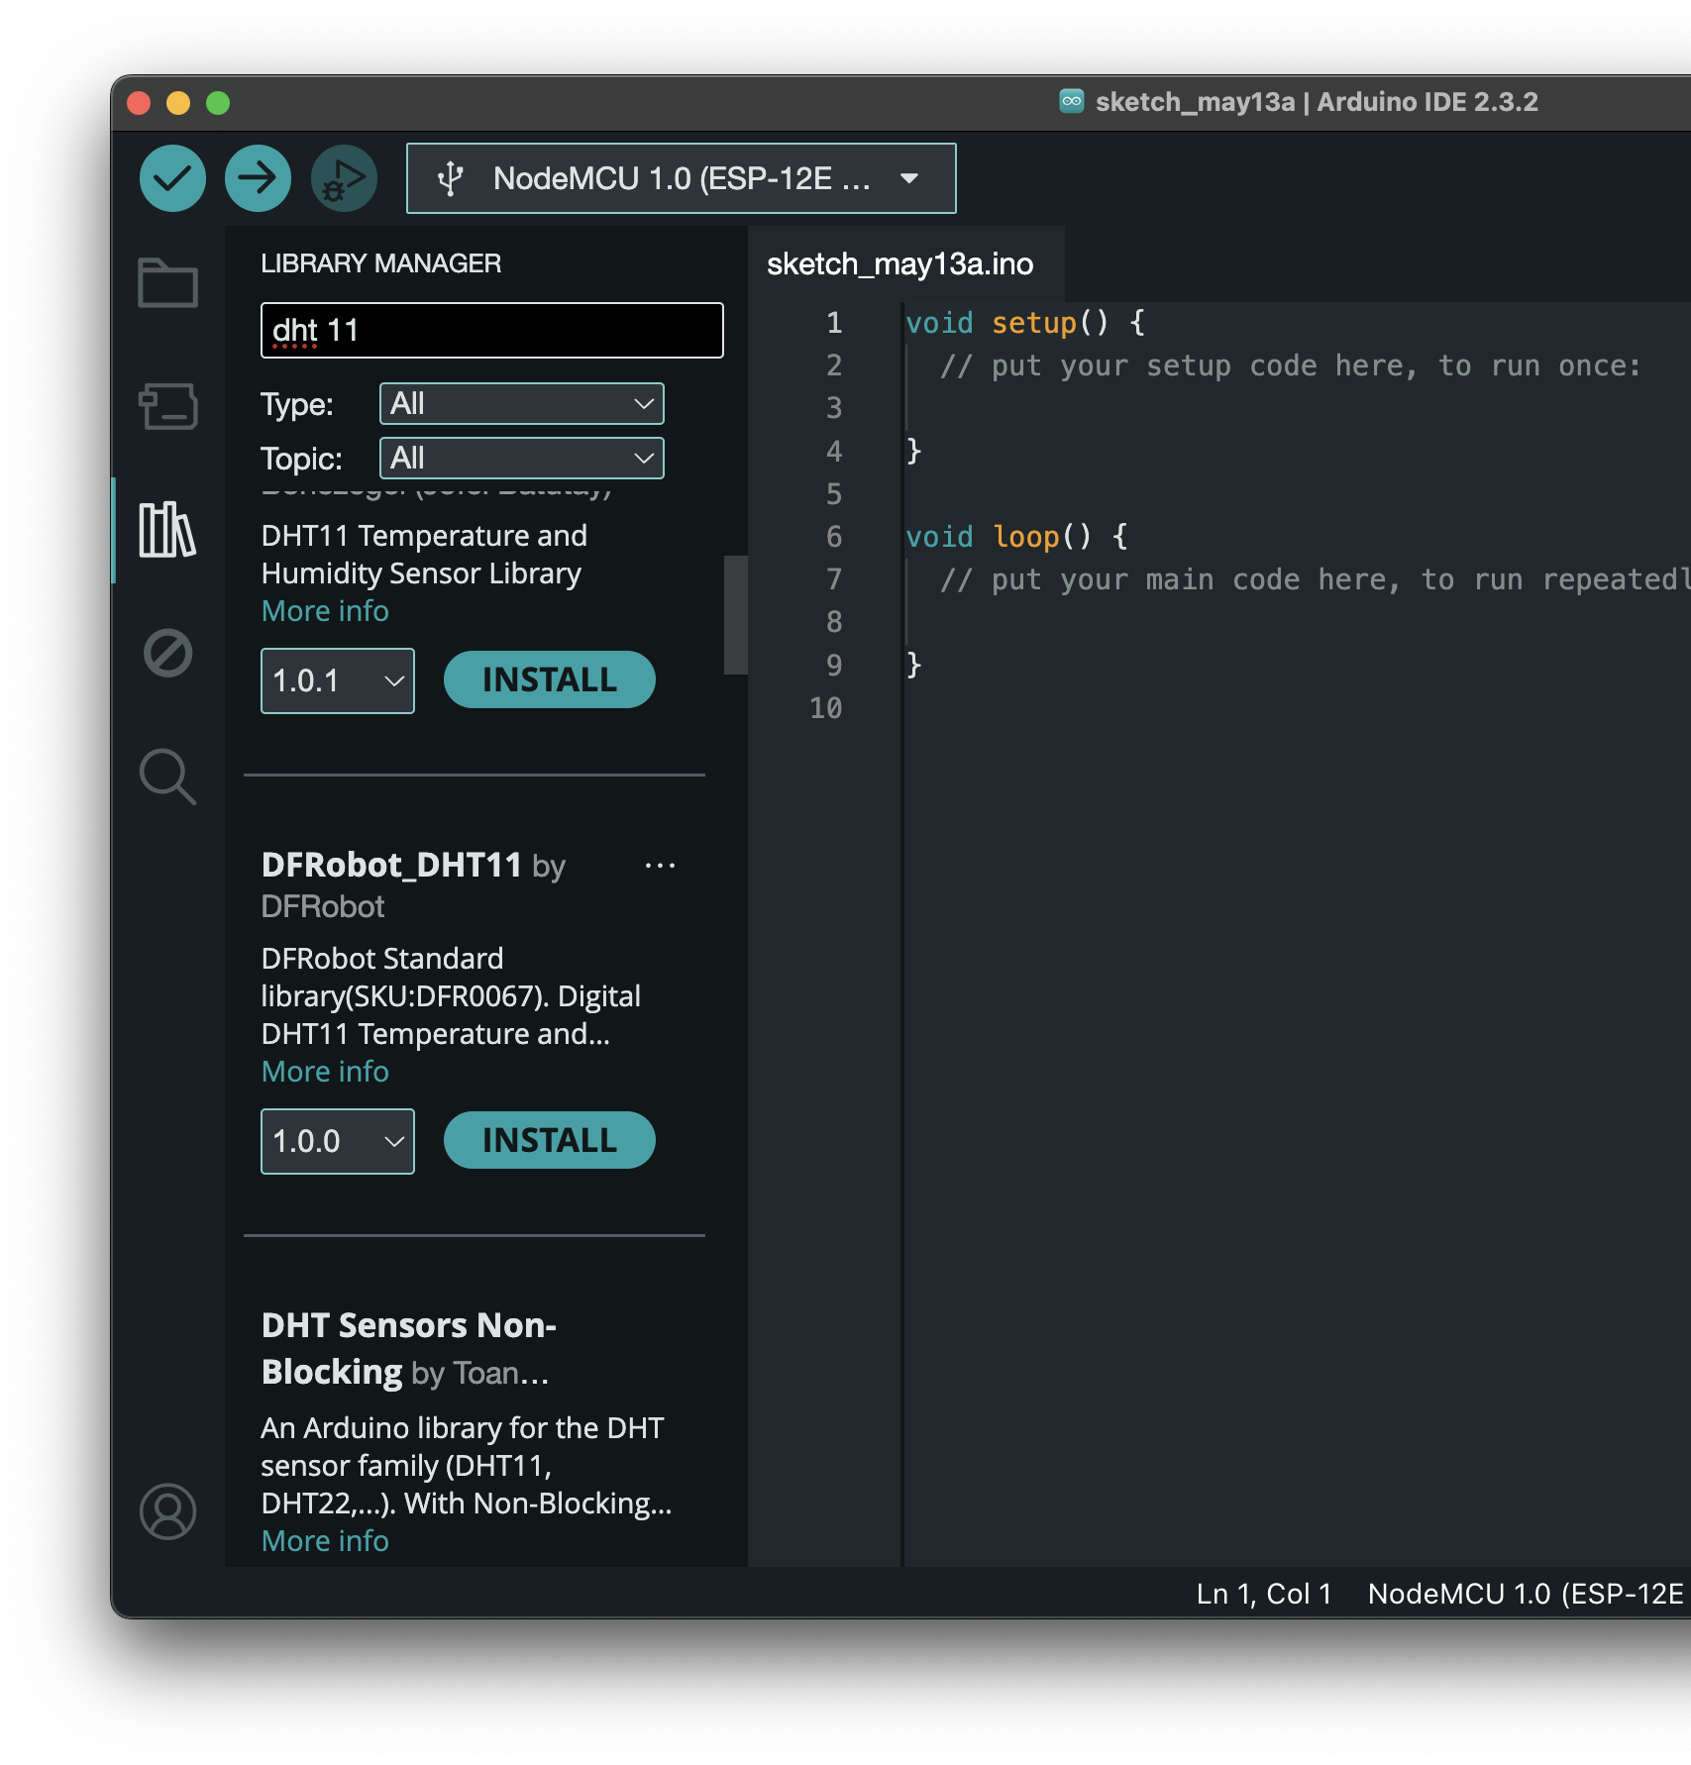
Arduino libraries
Dont worry you wont have to interact with these data signals on a low level
Writing code to support these communication protocols and sensors from scratch takes alot of time and is impractical to do every single time
libraries on Arduino IDE are additional code that provide additional functions, adding support to various hardware

Slide 15
using the library
#include <DFRobot_DHT11.h>
DFRobot_DHT11 DHT;
#define DHT11_PIN 10
void setup(){
Serial.begin(115200);
}
void loop(){
DHT.read(DHT11_PIN);
Serial.print("temp:");
Serial.print(DHT.temperature);
Serial.print(" humi:");
Serial.println(DHT.humidity);
delay(1000);
}
DFRobot_DHT11 DHT; creates instance of the DHT11 object
#define DHT11_PIN 10 Set pin 10 as DHT data pin
DHT.read(DHT11_PIN); Reads Sensor value using communication process mentioned before
DHT.temperature Returns Temperature sensor value

